Slide 1
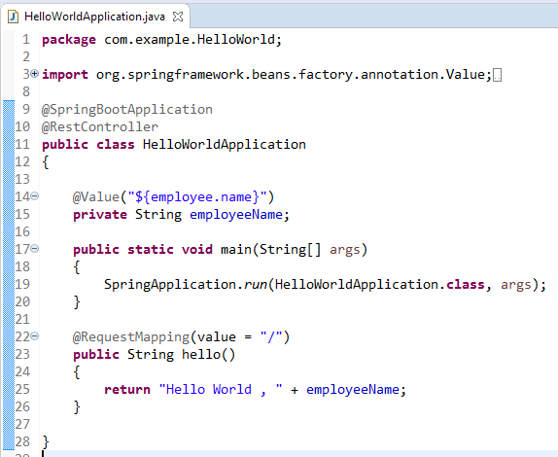

How to use @Value annotation in Spring Boot?
The @Value annotation is used to read the environment or application property value in Java code.
@Value("${property_key_name}")

